Slide 1
Application Layer Traffic Optimization (ALTO) WG
OpenALTO Implementation, Deployment Supporting LHCONE Use Cases Presenter: Lauren Delwiche on behalf of team (Jensen, Kai, …)
IETF 115 Hackathon
06 November 2022, London

Slide 2

Context: OpenALTO, openalto.org
openalto.org
OpenALTO is an open-source implementation and platform of ALTO (MIT License).
Available at https://github.com/openalto/alto
openalto.org is a running instance of deployment of OpenALTO, providing network information, in particular, in the context of data-intensive sciences, such as LHCONE.

Slide 3
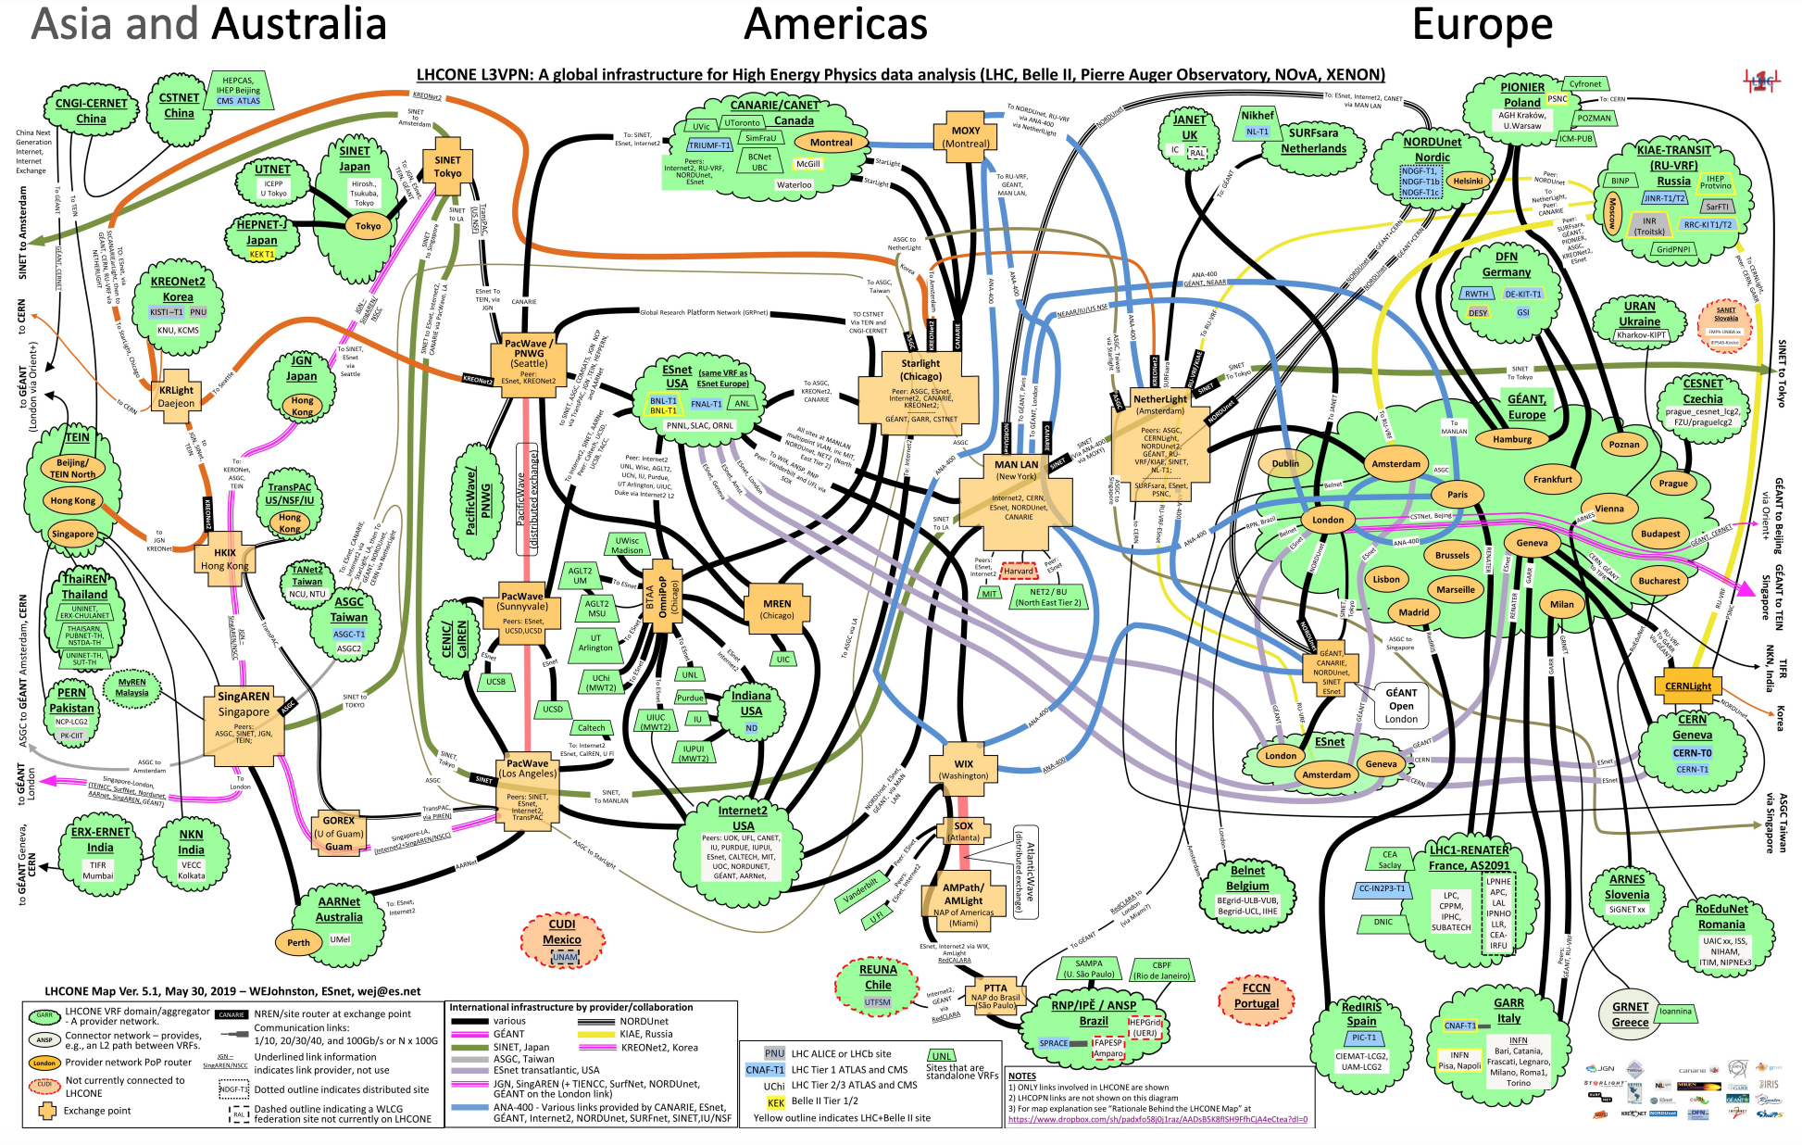
Context: LHCONE

Slide 4
Context: LHCONE, openalto.org Use Cases
ALTO+Rucio Integration: Data Flow Orchestration
Achievement IV: ALTO-based Replica Sorting Integration
ALTO/TCN+FTS Integration: Scheduling of Data Movement Tasks
openalto.org: visibility of LHCONE network routing state
Achievement I: GeoIP and GeoDistance
Achievement II: Obtain Routing Path
Achievement III: openalto.org as Global Query Orchestration

Slide 5
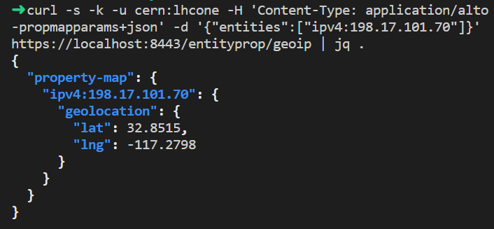
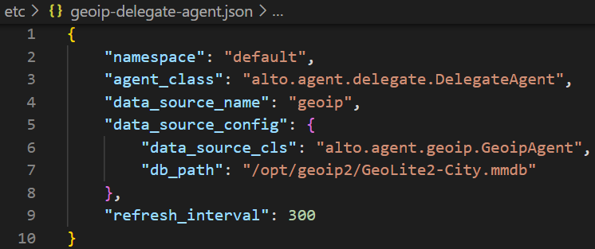
Hackathon Achievement I: GeoIP and GeoDistance
Providing geoip property using the standard ALTO endpoint property service [RFC 9240]
Providing geo distance between endpoints using the standard ALTO Endpoint Cost Service (ECS) [RFC 7285]
Query interface
Implementation Config
Notes:
Wording: Initial, not to change the default Rucio selecting data movement. GeoDistance is a default data movement selection mechanism in Rucio, and we now use alto to provide the standard implementation. Unifying the interface. Use download file; or use Web service

Slide 6
Hackathon Achievement II: Obtain Routing Paths
IETF ALTO Protocol as Front End
Control Plane
Data Plane Control: FIB
Data Plane Data: Sample
Config->FIB
FIB/DP driven
G2 snapshot
Samples (netflow, sflow)
PerfSonar (ICMP)
Equivalent Class
Looking Glass
P4
adjac
subnets
BGP input
<sw interface,
pkt attr>
<src, dst, <metric, val>>
Notes:
Wording: Initial, not to change the default Rucio selecting data movement. GeoDistance is a default data movement selection mechanism in Rucio, and we now use alto to provide the standard implementation. Unifying the interface. Use download file; or use Web service

Slide 7
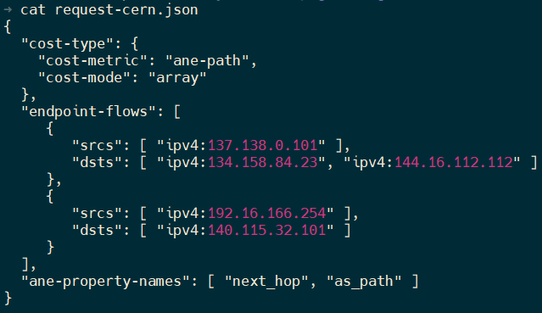
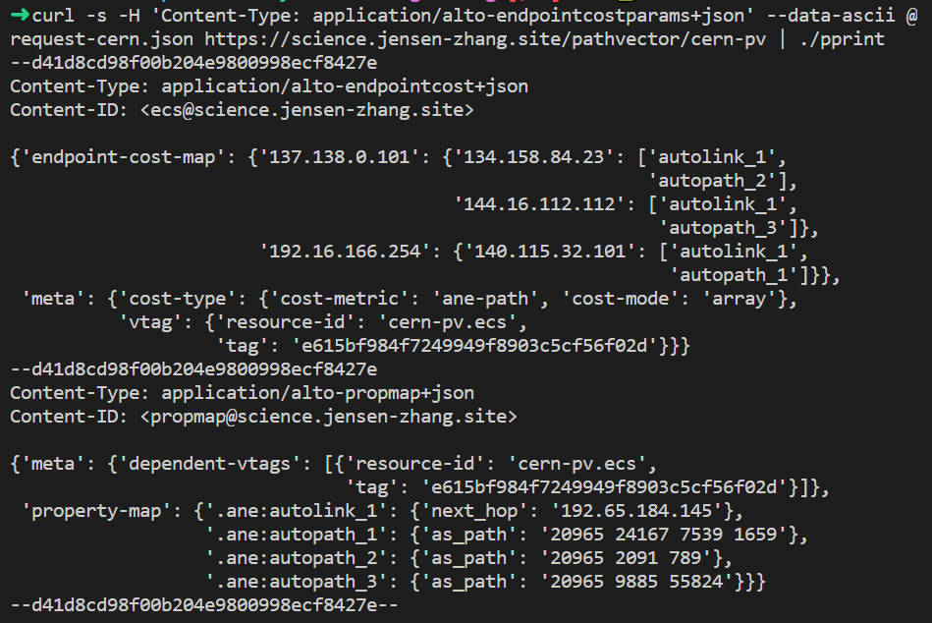
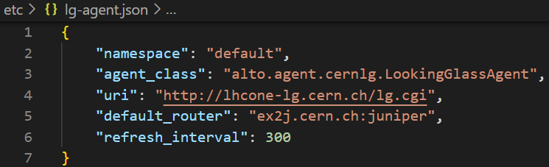
FIB/LG Driven Implementation
Query Example (ECS with path vector extension)
Response Example (ECS with path vector extension)
Query/Response
FIB Retrieval (LG; deployment at CERN and GEANT)
Implementation

Slide 8
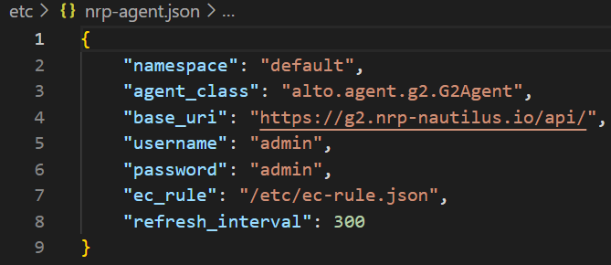
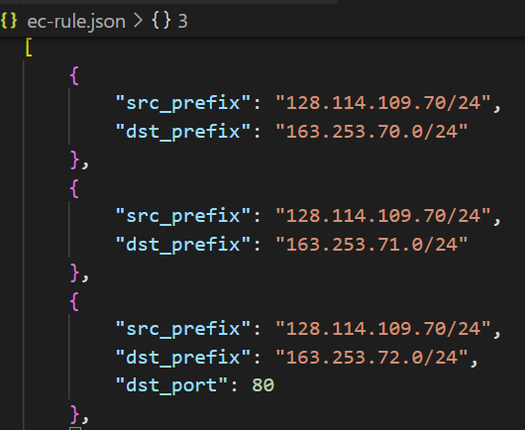
Data Path Sampling Driven Implementation
DP Sampling + Equivalent Class (Deployment at NRP)

Slide 9
Hackathon Achievement III: openalto.org as Global Query Orchestration Platform
Good progress, not complete implementation by end of Hackathon
High-level protocol query process: openalto.org orchestrates the multi-domain query process for LHCONE:
Lookup srcIP in Internet Routing Registry (IRR) to obtain source AS
Query ALTO server of source AS to obtain AS path
openalto.org refines the AS path to obtain general path representation
General path representation description given in WG email ( https://mailarchive.ietf.org/arch/msg/alto/2RMZgqSl2-wQ-eHKcnPyslPnzvs/)

Slide 10
Hackathon Achievement IV: Integration
Specify new ALTO resources to guide Rucio source selection
Ongoing: specify general path to modify FTS scheduling

Slide 11
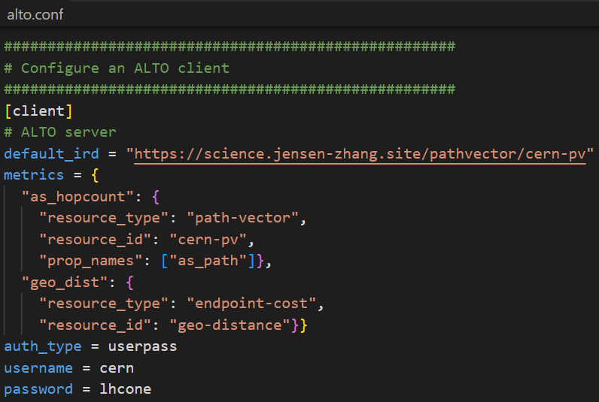
Sorting Replicas with ALTO Sorting Expression
Step 1: Configuration
Configure ALTO resources to fetch distances between replicas and the destination, and/or properties of replicas
Step 2: Express Sorting Demands
ALTO sorting expression enables Rucio download command to sort replicas based on a combination of distances and properties
BY=as_hopcount, geo_dist
WHERE continent=”EU”

Slide 12
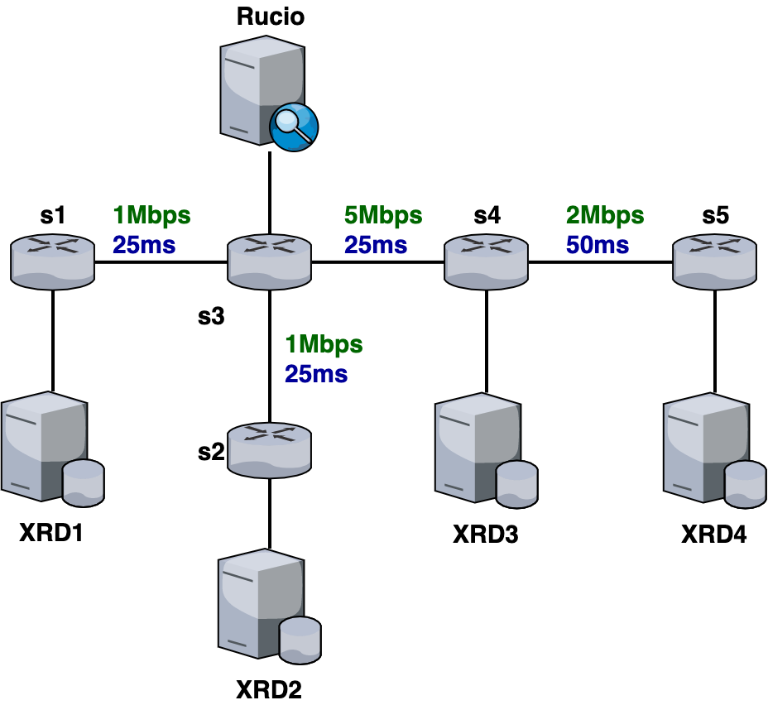
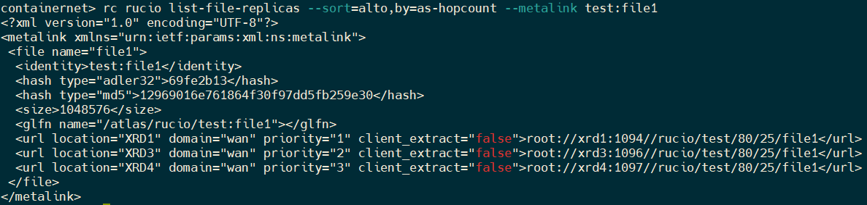
Hackathon Achievement IV: Integration
Use mininet to partially simulate the LHCONE network.
Host IPs are configured to the real public IPs in the real LHCONE network.
AS20965
AS293
AS38
AS513
AS57484
Example of rucio replica sorting using ALTO

Slide 13
Backup

Slide 14
Using the Visibility Information: Rucio
N sources of a data item
M potential destinations of the data item
Pick K out of M destinations to replicate
Basic Rucio algorithm
Foreach s in N (sources), d in M
Compute the distance Distance_sd (current Rucio, Distance_sd == geo distance of s and d)
For the case of Distance is general path representation, we need an algebra for comparing two paths
Sort the array Distance_sd (N x M) distances
dstChose = {}
while ( |dstChose | < K )
Pick the next lowest D_sd, if the dest d has not already been chosen, dstChose += {d} // delete all Distance_sd where d appears

